Slide 1
Business Process Engineering
Week 04

Slide 2
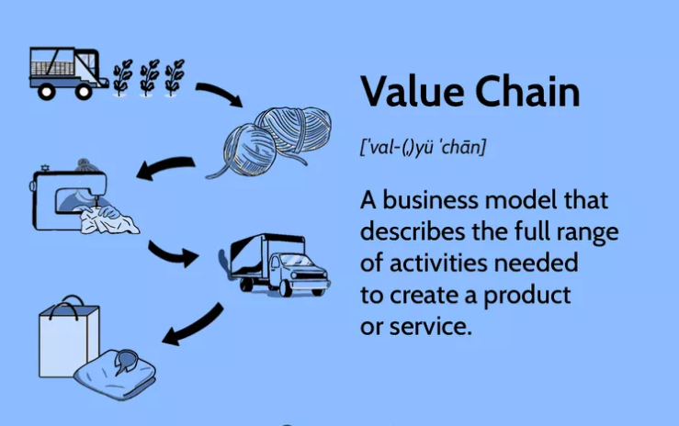

Slide 3
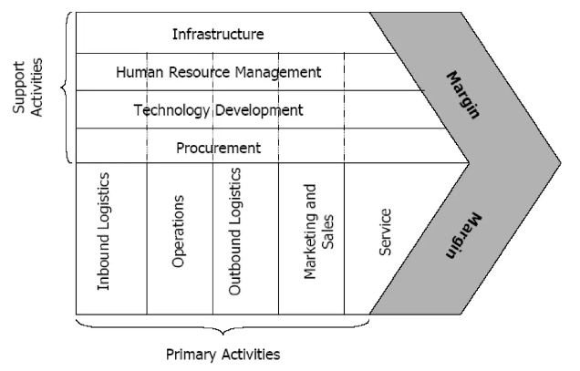
VC Model

Slide 4
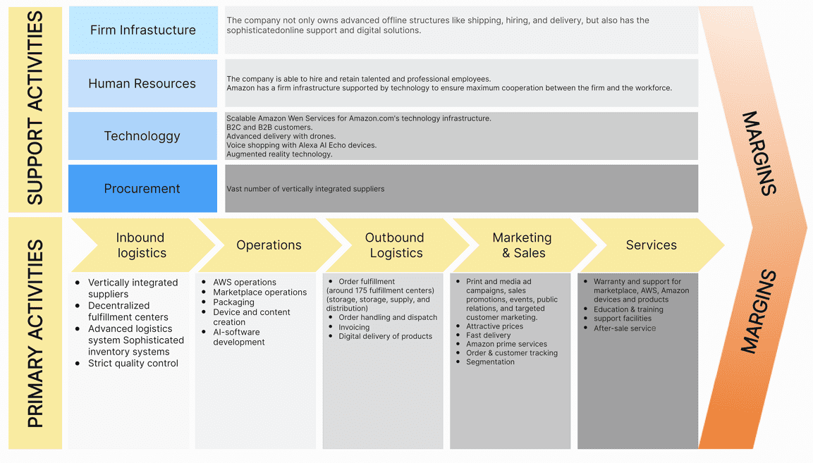
AMAZON VC

Slide 5
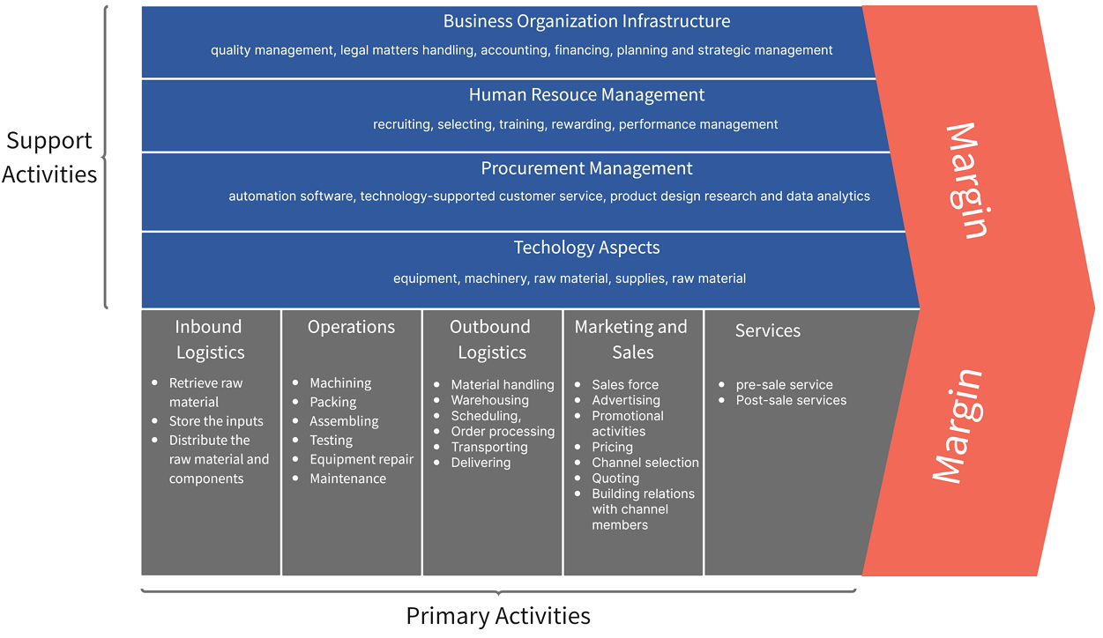
FedEx VC

Slide 6
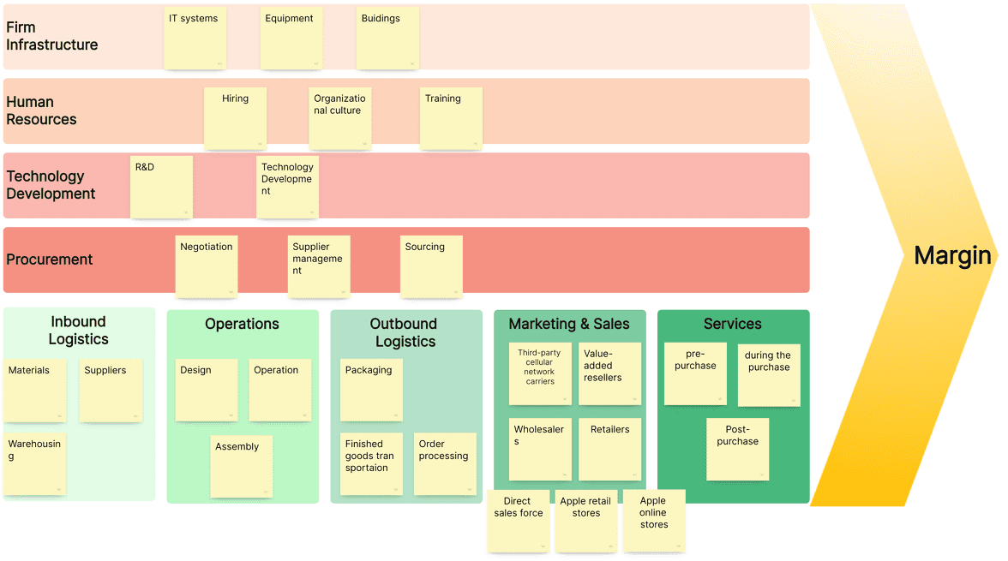
Apple Inc. VC

Slide 7
Business-to-Business Processes
Enterprise Services Computing
A service captures functionality with a business value that is ready to be used.
Services are made available by service providers.
A service requires a service description that can be accessed and understood by potential service requestors.
Software services are services that are realized by software systems.
Consider a real-world service, for example, one to fix a car. The service the garage provides needs to be specified in a way that the customer can find and use. Once the car is fixed, the customer pays the bill and the service is completed.

Slide 8
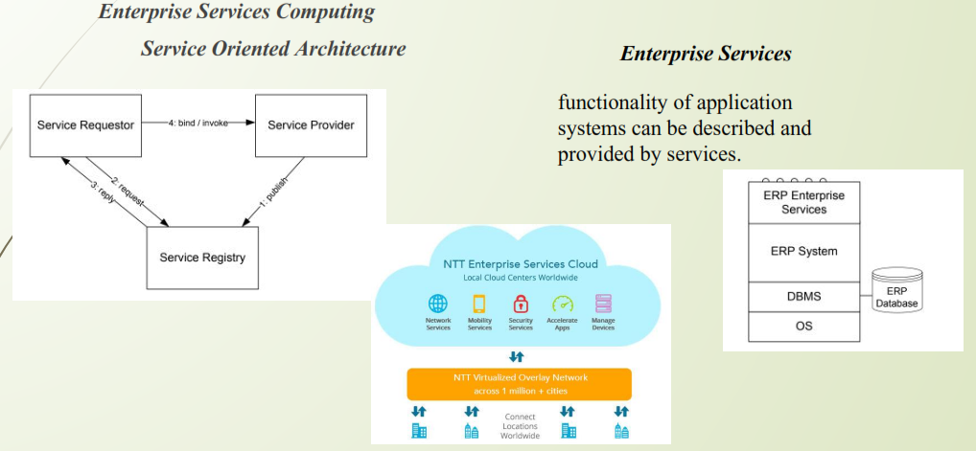
Business-to-Business Processes

Slide 9
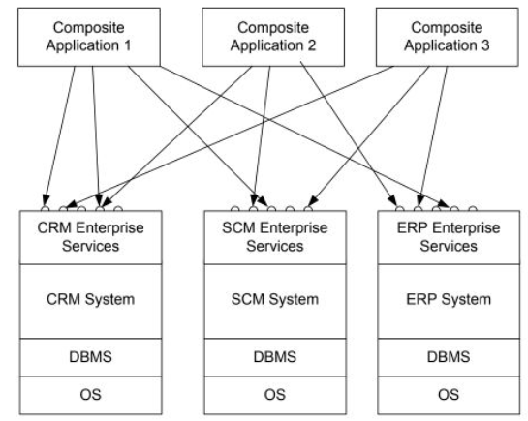
Composite Application
With this background in enterprise services architectures, an intra-company
scenario is sketched, where new applications should be built on top of an existing customer relationship management system, a supply chain management system, and an enterprise resource planning system. These systems expose enterprise services via standardized interfaces. The applications built on top are known as composite applications,

Slide 10
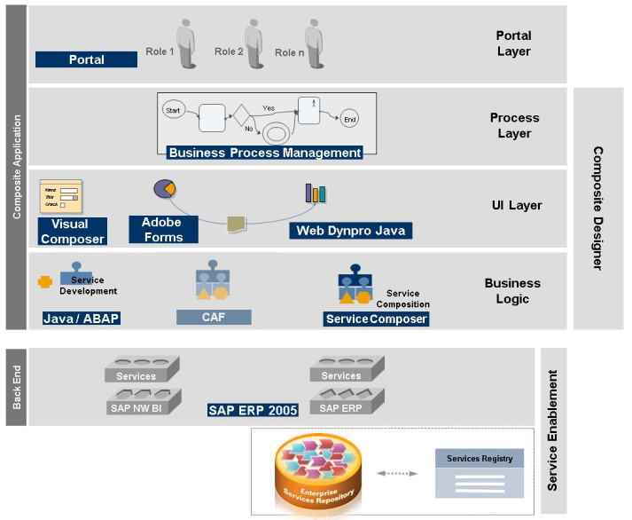

Slide 11
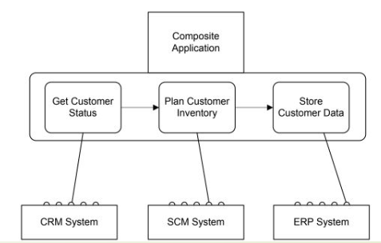
Service Composition
Using service composition to realize composite applications

Slide 12
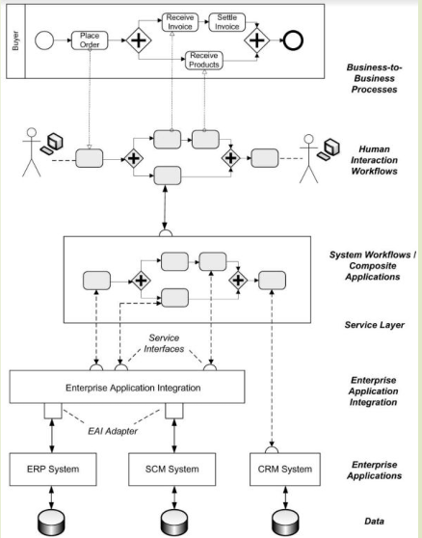
Business process management landscape
Workflow Management Coalition defines workflows and workflow management systems as follows.

Slide 13
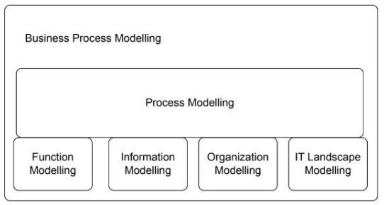
Business Process Modeling
Function modelling, data modelling, organization modelling, and modelling of the operational information technology landscape are required to provide a complete picture of a business process.

Slide 14
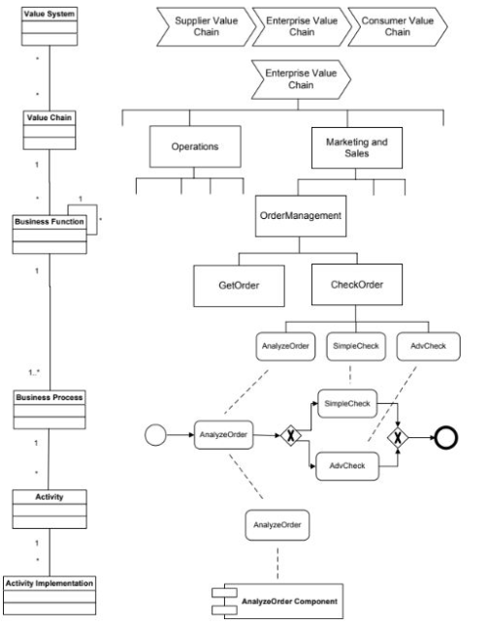


Slide 15
Conceptual Model:
Business processes consist of activities whose coordinated execution realizes some business goal. These activities can be:
1. system activities
2. user inter-action activities
3. manual activities.

Slide 16
Conceptual Model
1. Manual Activity
manual activity is sending a parcel to a business partner. Manual activities are not supported by information systems.
2. User Interaction Activity
human interaction activity is entering data on an insurance claim in a call center environment. There is no physical activity involved.
3. System Activity
System activities do not involve a human user; they are executed by in-formation systems. An example of a system activity is retrieving stock in formation from a stock-broker application or checking the balance of a bank account.

Slide 17
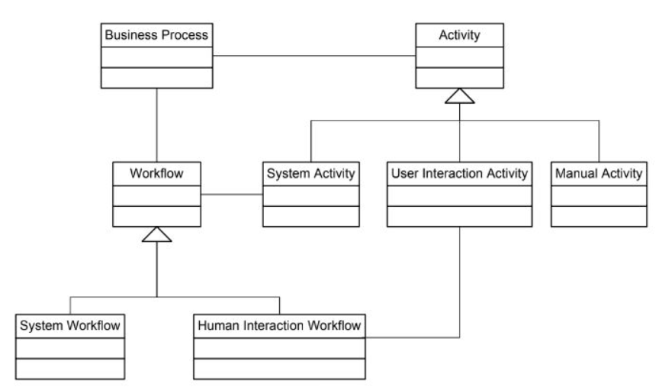

Slide 18
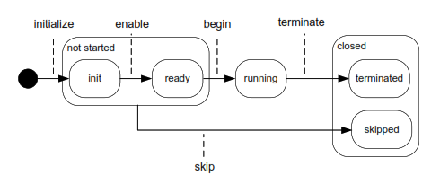

Slide 19
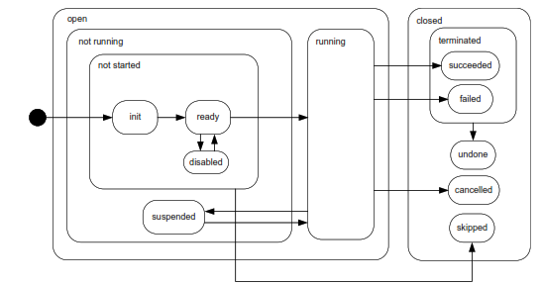

Slide 20
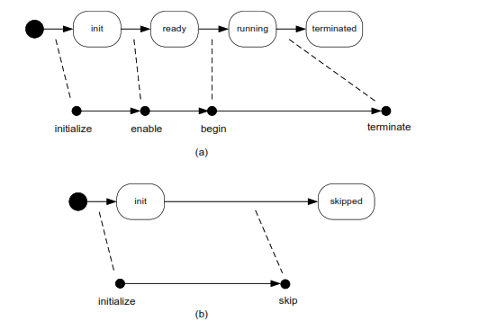

Slide 21
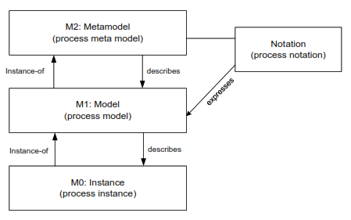
Process MetaModel
Business processes consist of a set of related activities whose coordinated execution contributes to the realization of a business function in a technical and organizational environment.
Business processes are represented by business process models.
Meta Object Facility (MOF) for the process
subdomain.

Slide 22
Process Models
Any modelling eﬀort starts with identifying the main concepts that need to be represented.
The following models are identiﬁed as concepts in the metamodel.
Process Model: A process model represents a blue-print for a set of process instances with a similar structure.
Consists of a set of activity models.
Nesting of process models within process models is not represented,
Each process model consists of nodes and directed edges

Slide 23
Process Models
Edge: Directed edges are used to express the relationships between nodes in a process model.
Node: A node in a process model can represent an activity model, an event model, or a gateway model.
Activity Models: Activity models describe units of work conducted in a business process. Each activity model has exactly one incoming edge and exactly one outgoing edge.
Event models: Event models capture the occurrence of states relevant for a business process. Process instances start and end with events, so process models start and end with event models.
Gateway Models: Gateways are used to express control ﬂow constructs, including sequences, as well as split and join nodes.

Slide 24
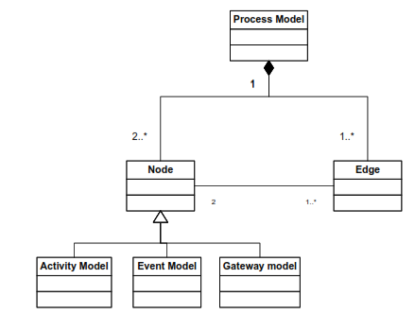

Slide 25
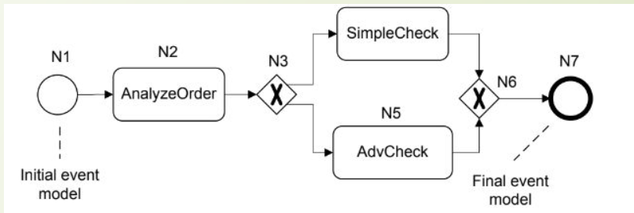
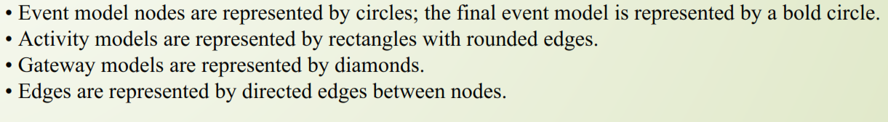

Slide 26
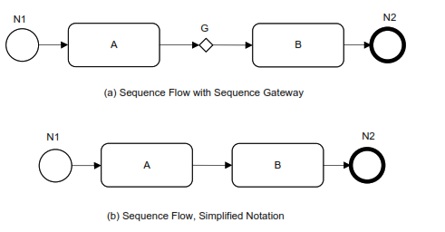
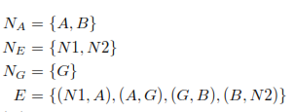
Let C be a set of control ﬂow constructs.
P = (N, E, type) is a process model if it consists of a set N of nodes, and a set E of edges.
• N = NA ∪ NE ∪ NG, where NA is a set of activity models, NE is a set of event models, and NG is a set of gateway models. These sets are mutually disjoint.

Slide 27
Gateways
Gateways are used to control how the Process flows through Sequence Flows as they converge and diverge within a Process.
Route a sequence flow following a decision,
using an exclusive or inclusive gateway; or alternatively
Undertake activities in parallel, using the parallel gateway.
Gateways are shaped like the Decision Diamonds

Slide 28
there are only a 6 types of Gateways:
Exclusive Gateways;
Inclusive Gateways;
Parallel Gateways;
Event Based Gateways;
Parallel Event Based Gateways; and
Complex Gateways.

Slide 29

Exclusive Gateway
The Exclusive Gateway is used to create alternative paths within a Process flow.
It is the “diversion point in the road” for a Process.
The Exclusive Gateway represents the need to make a decision where only one of the paths can be taken

Slide 30

Inclusive Gateway
The Inclusive Gateway is used to create both alternative and parallel paths within a Process flow.
The Inclusive Gateway represents the need to make a decision where all conditions must be evaluated.
Whilst the Inclusive Gateway can be used to show that all paths must be taken, it should be used in such a way that at least one of the paths is taken.

Slide 31
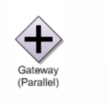
Parallel Gateway
The Parallel Gateway is used to represent parallel paths in a process.
The Parallel Gateway does not check any conditions and
Will wait for all incoming flows before triggering the parallel path.

Slide 32

Event Based Gateway
The Event-Based Gateway represents a branching point in the Process where the alternative paths that follow the Gateway are based on Events that occur rather than the evaluation of the process flow that lead to this point.
A specific Event such as the receipt of a message from a customer, determines the path that will be taken.

Slide 33

Complex Gateways
The Complex Gateway is used to represent complex synchronisation behaviour in a process.
A complex gateway is used when one or more of the outgoing sequence flows from the decision may be taken.
The Complex Gateway must have a default path.

Slide 34

Parallel Start Gateway

Slide 35
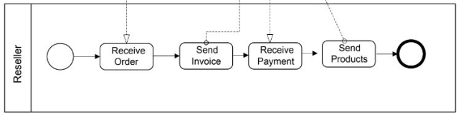
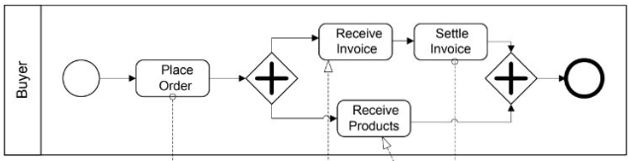
Example

Slide 36
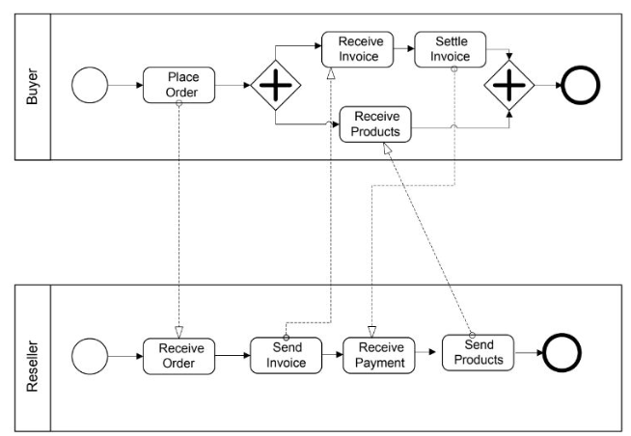
Process Interactions

Slide 37
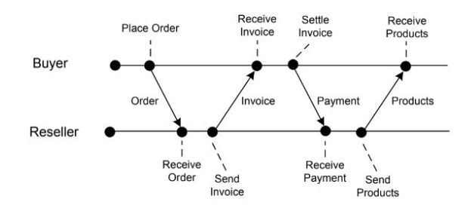
Event Diagram

Slide 38
Modelling Process Data
Business processes operate on data.
Explicitly representing data, data types, and data dependencies between activities of a business process puts a business process management system in a position to control the transfer of relevant data as generated and processed during processes enactment.
Data modelling is at the core of database design.
The Entity Relationship approach is used to classify and organize data in a given application domain.

Slide 39
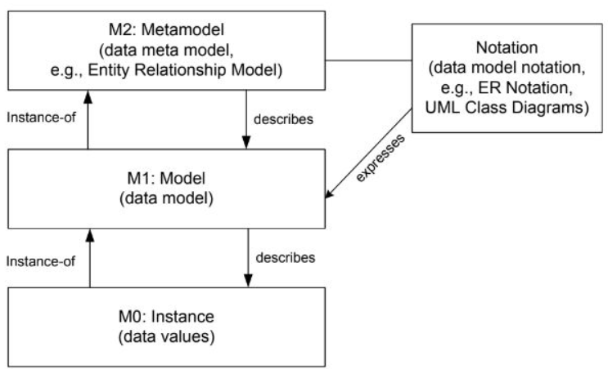
Metamodel for Data

Slide 40
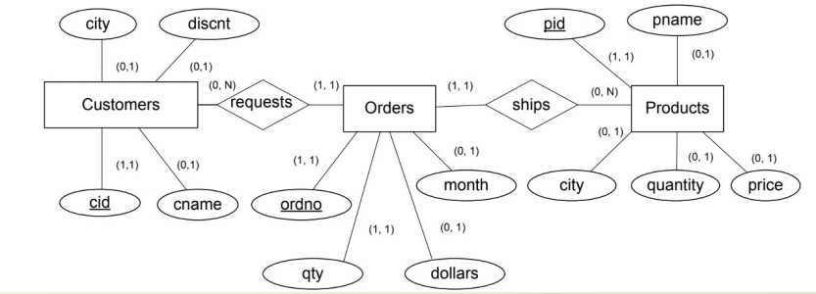
Modelling Process Data

Slide 41

To organize data-related issues in business process management, workflow data patterns have been introduced.
Purpose: how to handle data in business processes.
They are organized according to the dimensions:
Data visibility
Data interaction
Data transfer
Data-based routing.

Slide 42
Data Visibility
The most important workflow data patterns regarding data visibility are as follows.
1. Task data: The data object is local to a particular activity; it is not visible to other activities of the same process or other processes.
2. Block data: The data object is visible to all activities of a given subprocess.
3. Workflow data: The data object is visible to all activities of a given business process, but access is restricted by the business process management system, as defined in the business process model.
4. Environment data: Data elements which exist in the external operating environment are able to be accessed by components of processes during execution.

Slide 43
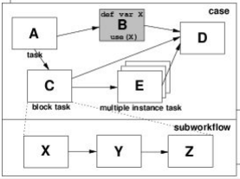
Task data

Slide 44
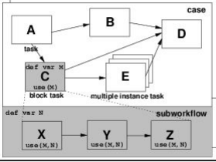
Block data

Slide 45
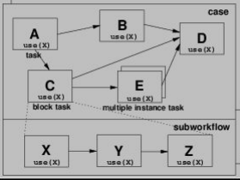
Workflow data

Slide 46
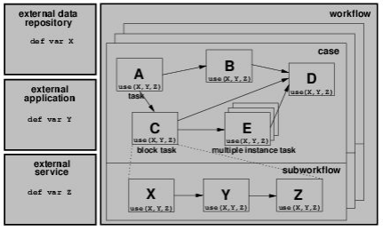
Environment data

Slide 47
Workflow Data Patterns
Data interaction patterns: Data can also be communicated between the business process and the business process management system.
Data Transfer: These data transfer patterns are very similar to call-by-value and call-by-reference, concepts used in programming languages to invoke procedures and functions.
Data base routing: data can have different implications on process enactment. In the simplest case, the presence of a data object can enable a process activity. Data objects can also be used to evaluate conditions in business process models, for instance, to decide on the particular branch to take in a split node.

Slide 48
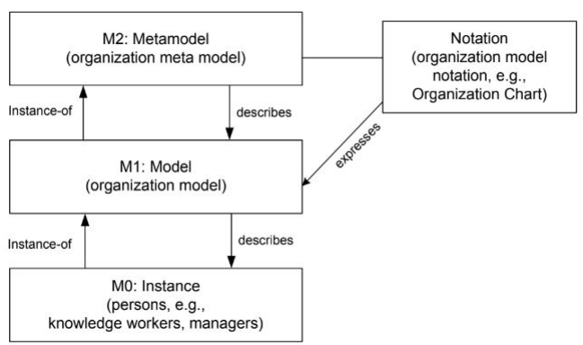
Modelling Organization

Slide 49
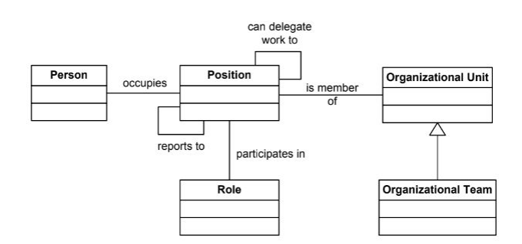
Organization metamodel

Slide 50
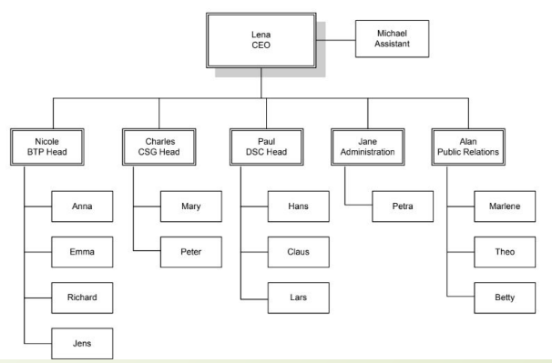
Sample organizational chart

Slide 51
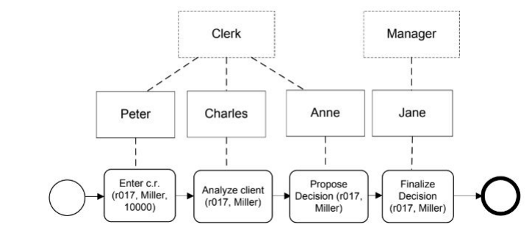
Roll Information

Slide 52
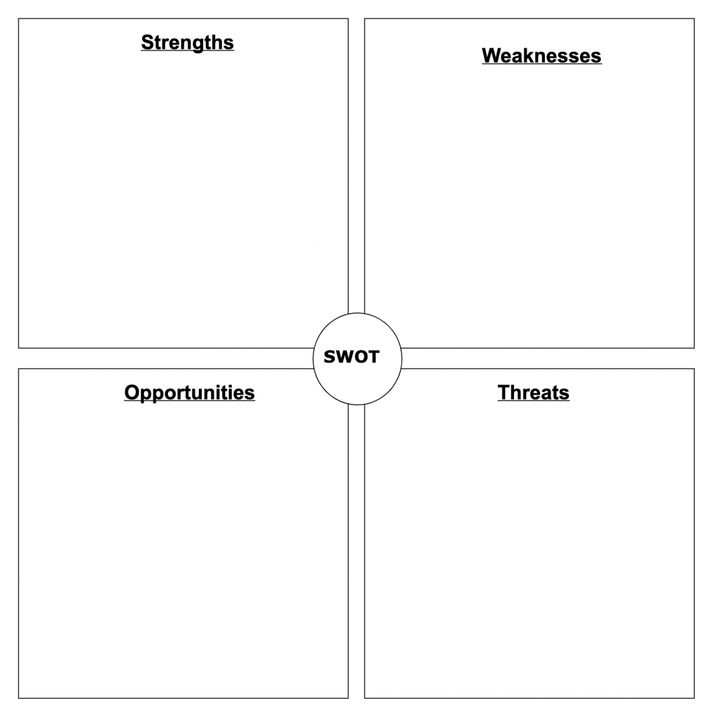
SWOT Analysis

